Slide 1

Law of Supply
Copyright@ Ashis Kumar Pradhan

Slide 2

What is supply?
‘Supply refers to the quantity of a commodity which producers or sellers are willing to produce and offer for sale at a particular price’, in a given market, at a particular period of time.

Slide 3
The three important aspects of supply
Supply is a desired quantity
Supply is always explained with reference to price
Time during which it is offered for sale

Slide 4
Supply Schedule and Supply Curve
Supply schedule shows a tabular representation of law of supply. It presents the different quantities of a product that a seller is willing to sell at different price levels of that product.
The graphical representation of supply schedule is called supply curve.
Supply Schedule and Supply Curve are of two types
1) Individual Supply Schedule & Individual Supply Curve
2) Market Supply Schedule & Market Supply Curve

Slide 5
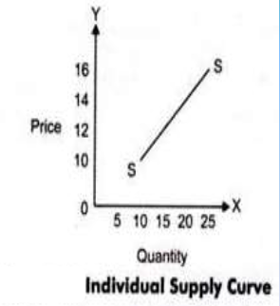
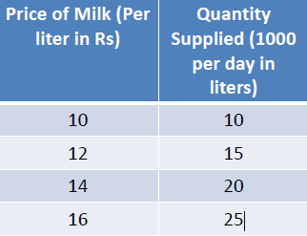
Individual supply schedule & Individual Supply Curve
Refers to a supply schedule that represents the different quantities of a product supplied by an individual seller at different prices.
The supply curve is showing a straight line and an upward slope. This implies that the supply of a product increases with increase in the price of a product.

Slide 6
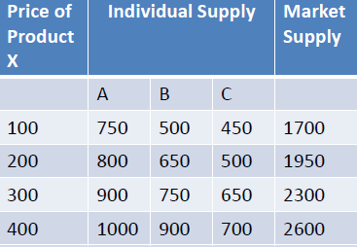
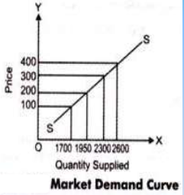
Market Supply schedule & Market Supply Curve
Refers to a supply schedule that represents the different quantities of a product that all the suppliers in the market are willing to supply at different prices.
Market supply curve also represents the direct relationship between the quantity supplied and price of a product.

Slide 7
Supply Function or Determinants of Supply
Supply function studies the functional relationship between supply of a commodity and its various determinants.
Sx = f ( Px, PR, NF, G, PF, T, Ex, GP)
Where,
Sx = Supply of a Commodity
Px = Price of the Commodity
PR = Price of the Related Goods
NF = Number of Firms
G = Goal of the Firm
PF = Price of factors of Production
T = Technology
Ex = Expected Future Price
GP = Government Policy

Slide 8
Price of the Commodity
There is a direct relationship between price of a commodity and its quantity supplied. When price increases, supply also increases because it motivate the firm to supply more in order to get more profit. When price decreases, smaller quantity will be supplied as profit decreases.

Slide 9
Price of Related Goods
Producers always have the tendency of shifting from the production of one commodity to another commodity. If the prices of another commodity increases, especially substitute goods, producers will find it more profitable to produce that commodity by reducing the production of the existing commodity.
For Example: Suppose the seller of tea notice that the price of coffee increases . They may reduce the amount of resources devoted to the selling of tea in favour of coffee.

Slide 10
Number of Firms
Market supply of a commodity depends upon number of firms in the market. Increase in the number of firms implies increase in the market supply, and decrease in the number of firms implies decrease in the market supply of a commodity.

Slide 11
Goal of the Firm
If goal of the firm is to maximise profits, more quantity of the commodity will be offered at a higher price.
On the other hand, if goal of the firm is to maximise sale more will be supplied even at the same price.

Slide 12
Price of the Factor of Production
Supply of a commodity is also affected by the price of factors used for the production of the commodity.
If the factor price decreases, cost of production also reduces.
Accordingly, more of the commodity is supplied at its existing price.
Conversely, if the factor price increases cost of production also increases. In such a situation less of the commodity is supplied at its existing price.

Slide 13
Change in Technology
Change in technology also affects supply of the commodity.
Improvement in the technique of production reduce cost of production Consequently, more of the commodity is supplied at its existing price.

Slide 14
Expected Future Price
If the producer expects price of the commodity to rise in the near future, current supply of the commodity will reduce.
If, on the other hand, fall in the price is expected, current supply will increase.

Slide 15
Government Policy
‘Taxation and Subsidy’ policy of the government affects market supply of the commodity.
Increase in taxation tends to reduce supply. On the other hand, subsidies tend to increase supply of the commodity.

Slide 16
THE LAW OF SUPPLY
‘Law of supply states that other things remaining the same, the quantity of any commodity that firms will produce and offer for sale rises with rise in price and falls with fall in price.’
i.e. Higher the price, higher will be quantity supplied and lower the price smaller will be quantity supplied.
‘Other things remaining the same’ means determinants other than own price such as technology, goals of the firm, government policy, price of related goods etc. should not change.

Slide 17
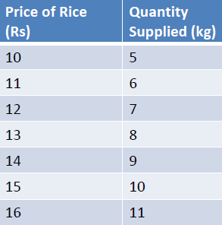
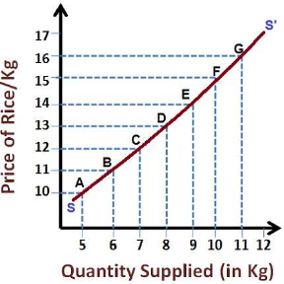
THE LAW OF SUPPLY
SS Slopes upward from left to right.
It shows positive relationship between price of the commodity and its quantity supplied.
As price rises quantity supplied also rises.

Slide 18
Exceptions to the Law of Supply
The law of supply does not apply strictly to agricultural products whose supply is governed by natural factors. If due to natural calamities, there is fall in the production of wheat, then its supply will not increase, however high the price may be.
Seller may be willing to sell more units of a perishable commodity at a lower price.

Slide 19
Why Does Supply Curve Slope Upwards?
The level of price determines profit. i.e. higher the price, higher the profit and vice versa. So higher the price, the greater is the incentive for the producer to produce and supply more in the market, other things remain the same.
Positive slope of supply curve is also caused by the rise in the cost of production. Usually cost of production increases with increase in production. In this situation a producer will produce and sell more units only at a higher price.
The rise in price also motivates other producers to produce this commodity so as to earn higher profit.

Slide 20
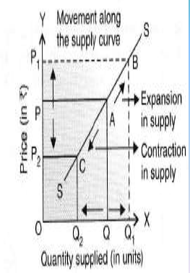
Change in Quantity Supplied or Extension and Contraction of Supply
Increase in quantity supplied of a commodity due to rise in its price is called Extension of Supply and decrease in quantity supplied due to fall in its price is called Contraction of Supply.
There will be a movement in
Supply curve.

Slide 21
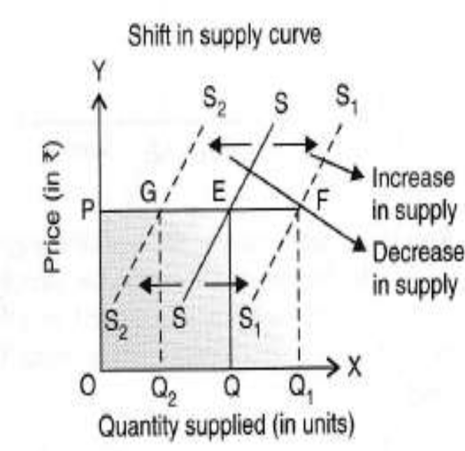
Change in Supply or Increase and Decrease in Supply
Increase in Supply occurs when more is supplied at the existing price, while decrease in supply occurs when less is supplied at the existing price. While increase in supply cause a forward shift in supply curve, decrease in supply cause a backward shift in supply curve.

